Slide 1

January 6, 2016
The 4 Rules of Simple Design
Applied to complex software
Notes:
Headline: Georgia, 47pt
Subhead: Georgia, 32pt
Right Aligned
Note: Feel free to adjust sizing to fit
Note: Delete “Confidential” if not needed

Slide 2

This is how we roll
Notes:
- Ruby/Rails
- Pair Programming
- TDD
- Remote Development

Slide 3
Complex Products != Complex Designs
“
Simple software design enables simple humans to maintain immensely complex systems.

Slide 4
What are the 4 rules?
Tests Pass
Expresses Intent
No Duplication (DRY)
Small
Understanding the 4 Rules of Simple Design – Corey Haines

Slide 5
It’s about humans
Tests Pass (gives me confidence)
Expresses Intent (informs me)
No Duplication (avoids confusion)
Small (fits in my head)
Beware of geniuses

Slide 6
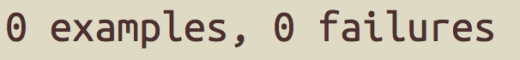
TESTS PASS

Slide 7
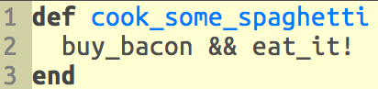
EXPRESSES INTENT

Slide 8
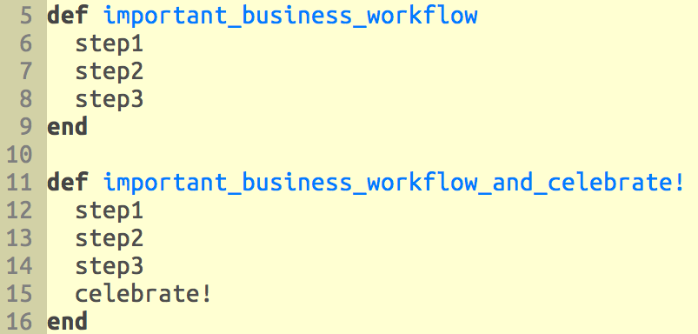
No Duplication (DRY)

Slide 9
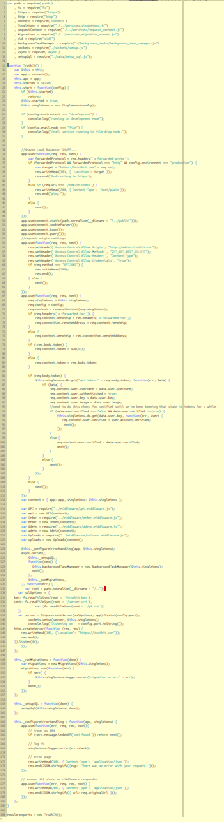
SMALL

Slide 10

Building a Complex Product
Day 1

Slide 11

Building a Complex Product
Is this Your Future?

Slide 12
Applying the Rules
Breaking down our spaghetti problem into smaller spaghetti problems.
Notes:
––

Slide 13
Apply the Rules
Organization
Systems
Code

Slide 14
Applying the Rules - Organization

Slide 15
Applying the Rules - Systems

Slide 16
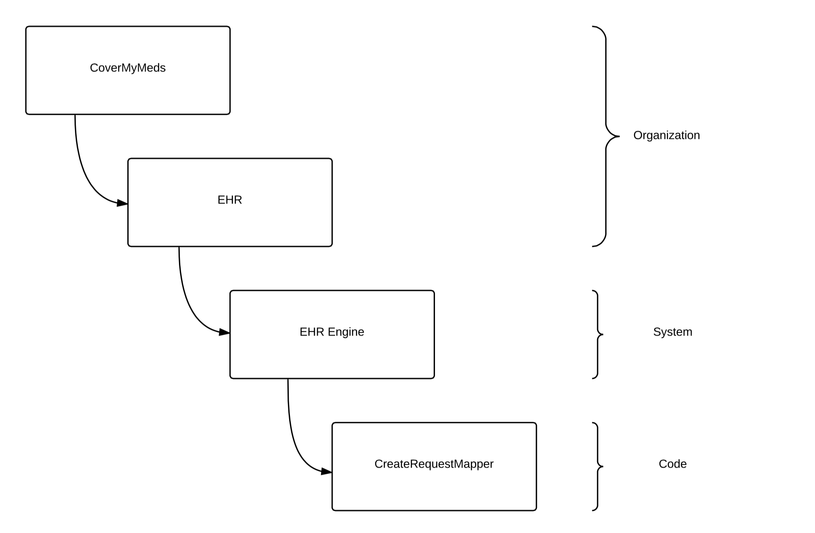
Applying the Rules - Code
Notes:
––

Slide 17
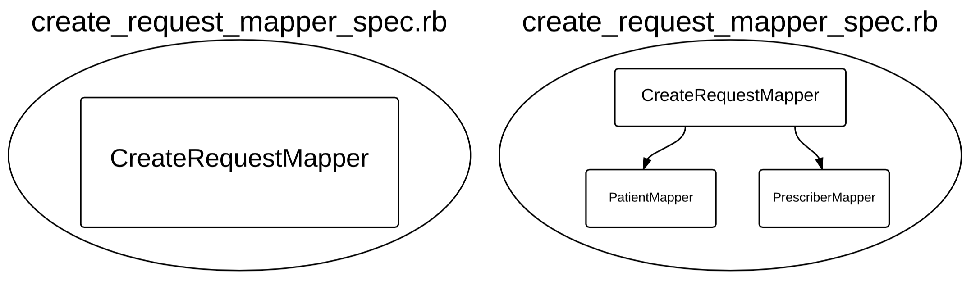
Applying the Rules – Passes Tests
Notes:
––

Slide 18
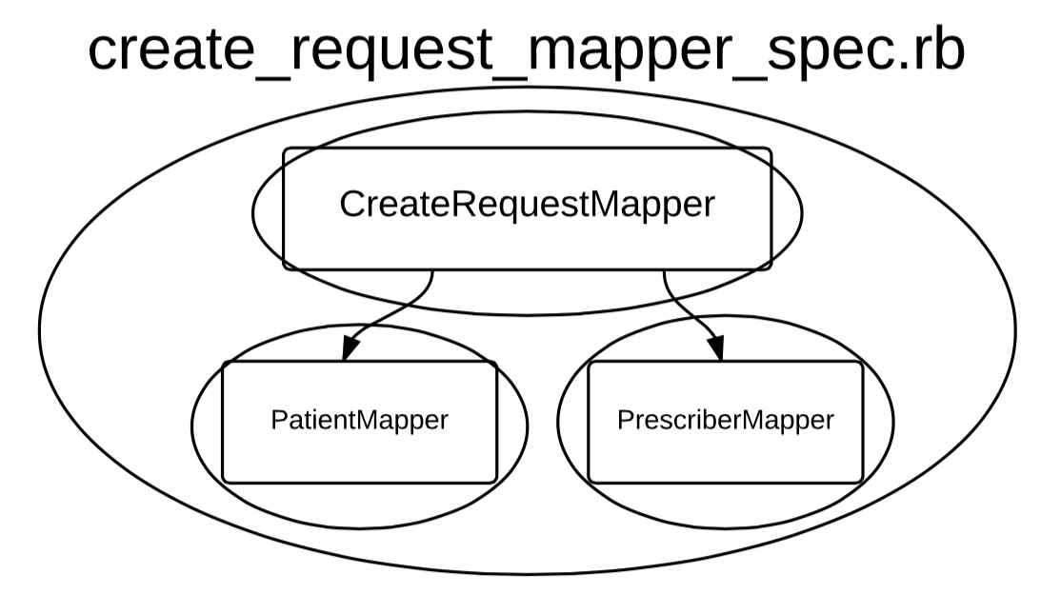
Applying the Rules – Passes Tests
Chasing the Implementation
Notes:
––

